Slide 1

DEPARTMENT OF COMPUTER SCIENCE & ENGINEERING
“LIBRARY MANAGEMENT SYSTEM”
COURSE NAME : MINI PROJECT IN PYTHON
COURSE CODE: 20CSE59
Under the Guidance of,
Guide Name & Designation:
Ms. Priya T V
Presentation by,
NAME : SIMRAN JHA
USN : 1NH20CS270

Slide 2
Abstract
The main objective of this project is to develop a Library Management System using Python. This is one of the advantageous projects where a user interacts with the system to record some important files or store their record for longer use. Now the question arises when we have the same facility in physical handed files then what’s the use of going through programming and solve the same issue which can be resolved to some extent through physical means.
Losing records and struggle behind maintaining those was a tedious task. Owing to the technology advancement, this tedious task can be simpler and reduced to more effective way. Library Management System through programming has been designed in such a way to computerize every such operations, for example to insert a record, delete, books issued and borrowed with clearly mentioned the respective dates and time.
This in turn reduces the workload and will be more secured if such a platform is created where the users can login as per their use and be accessed by that particular user only. This can further be improved if lot of functions and advanced version is installed and linked with this management system.

Slide 3
Acknowledgement
The satisfaction and euphoria that accompany the successful completion of any task would be impossible without the mention of the people who made it possible, whose constant guidance and encouragement crowned our efforts with success.
I have great pleasure in expressing gratitude to Dr. Mohan Manghnani, Chairman, New Horizon Educational Institutions, for providing necessary infrastructure and creating good environment.
I take this opportunity to express my profound gratitude to Dr. Manjunatha, Principal, New Horizon College of Engineering, for his constant support and encouragement.
I would also like to thank Dr. B. Rajalakshmi, Professor and HOD, Department of Computer Science and Engineering, for her constant support.
I also express my gratitude to Ms. Priya TV, Department of Computer Science and Engineering, my mini project reviewer, for constantly monitoring the development of the project and setting up precise deadlines. Her valuable suggestions were the motivating factors in completing the work.

Slide 4
Agenda
Introduction
Methodology
Literature survey / Existing system
Limitations of Existing System
Problem Definition
Objectives
Algorithm / Flowchart
Hardware & Software Requirements
Conclusion
References

Slide 5
Introduction
A Library Management System is a computerized form of executing the library operations through online platform using programming, here using Python language using necessary library files as it makes more easier to form the source code and compile it.
This type of projects are very flexible since it can be made in small, medium or large level. Library Management System works with the aim of reducing the manual workload and to be executed in real life in more effective way so that even if there is a need in future, we should not be facing any hassle during that time in obtaining a record within fraction of seconds.
Here, Concatenating GUI(graphical user interface) with the database used is the most popular project idea. So we will be required MySQL and GUI library ‘tkinter’. The admin can easily access all the useful functions such as Issue and Return along with the correct date including adding, deleting and even searching a book makes the project worthy.
Login User ID and Password makes it more secure as only those can have access to these functions.

Slide 6
Problem Definition
Problem statement in designing such management system:
File lost and damaged:
In a physical library, we have often noticed that old records and files are either lost or damaged in most of the scenarios due to mis-management or long-lost time disrupts the data.
Space Consuming:
Libraries are such place with is in numerous of documentations. More the records, the better the library collection but it’s very space consuming.
Time exhaustion:
If there’s a need to search any data or document or a book which might be few years old then it might consume a lot of time resulting in time exhaustion.
Difficulty in searching any record:
Again, to search such data which might not be important for near future but very necessary after a period of time then it’ll be very difficult to find such especially if in large number.
Cost Consuming:
Managing library records and often updating the collection is pretty cost consuming as there will be regular maintenance and invigilation as well as requirement of stationary.

Slide 7
Objectives
Refinement in control and performance:
A computerized library will never face such an issue of lost or damaging as it can store very old data without any hassle.
Task Enhancement/Advancement:
A library system through programming provides many add-on features like different users can have their own book room. Users can perform necessary operations on their records.
Save time:
No time will be wasted as within few clicks, desired data can be shown in screen within a few seconds, thus saving time and manual labour.
Secured System:
The project can be based only at administrative end and thus the authorized person is guaranteed the access if secured password function is applied.
Even if not, it is fully secured since nothing can be lost and timestamp is generated.
Cost Consuming:
Computerized library will never demand such cost consuming maintenance as it neither requires any sort of stationary nor such large rooms.

Slide 8
Methodology
This project is based upon (i) Database and (ii) GUI.
Hence we will use sqlite3 libraries and tkinter in Python.
Tkinter – It’s a standard Library based on GUI in Python. This also supports OOP Programming.
SQLite3 – On downloading this, it provides a SQL interface where we can input data as per our requirement which will directly reflect in final output of this project.
There’s going to be 3 databases in total which are –
Admin – Consisting of 2 columns in table : User ID and Password which controls as to who can login and access the Library.
Students Data – Consisting of attributes related to students who wants issue books and return after some time.
Books Data – Consisting of attributes related to books which are present in Library and are issued on the basis of it’s ID.
The admin can manipulate the data as per the requirement and add books as much as it should be there in a library.

Slide 9
Literature survey / Existing systems
Compiler user here is VISUAL STUDIO CODE.
Visual Studio Code is a source-code editor made by Microsoft for Windows, Linux and macOS. Features include support for debugging, syntax highlighting, intelligent code completion, snippets, code refactoring, and embedded Git. Users can change the theme, keyboard shortcuts, preferences, and install extensions that add additional functionality.
Visual Studio Code collects usage data and sends it to Microsoft, although this can be disabled. In addition, because of the open-source nature of the application, the telemetry code is accessible to the public, who can see exactly what is collected. According to Microsoft, the data is shared with Microsoft-controlled affiliates and subsidiaries, although law enforcement may request it as part of a legal process.
Second Software used here is SQLite studio3 which is a very advanced version to store long databases. There is a high usage of DBMS commands in basic software like MYSQL and typing those long commands makes the easy work tedious.
Hence SQLite3 provides with simple and pictorial representation of type of conditions it holds such primary key, unique key, not null and many more. This software connects a programming language and together shows the update based on what is required.

Slide 10
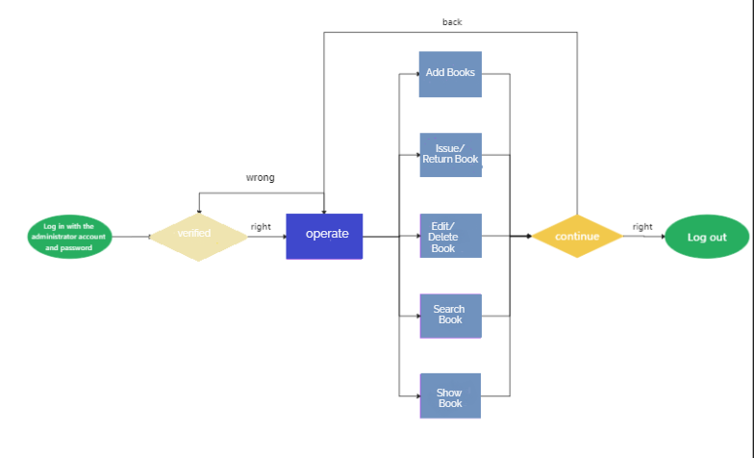
Flowchart

Slide 11
Hardware & Software Specification
Software Requirements
IDE supporting Python (VS Code, Spyder, etc.)
Python Extension (preferably from Microsoft)
Python necessary Extension
Hardware Requirements
Minimum 8 GB RAM
Minimum i5 8th Gen Intel Processor

Slide 12
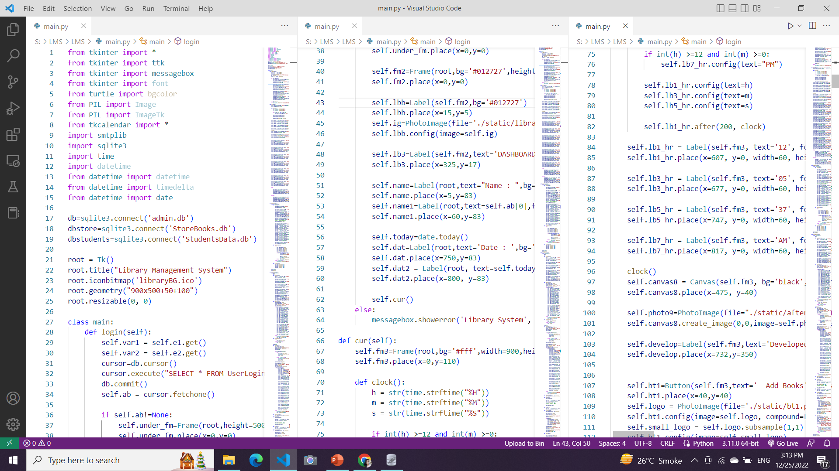
Partial Code

Slide 13
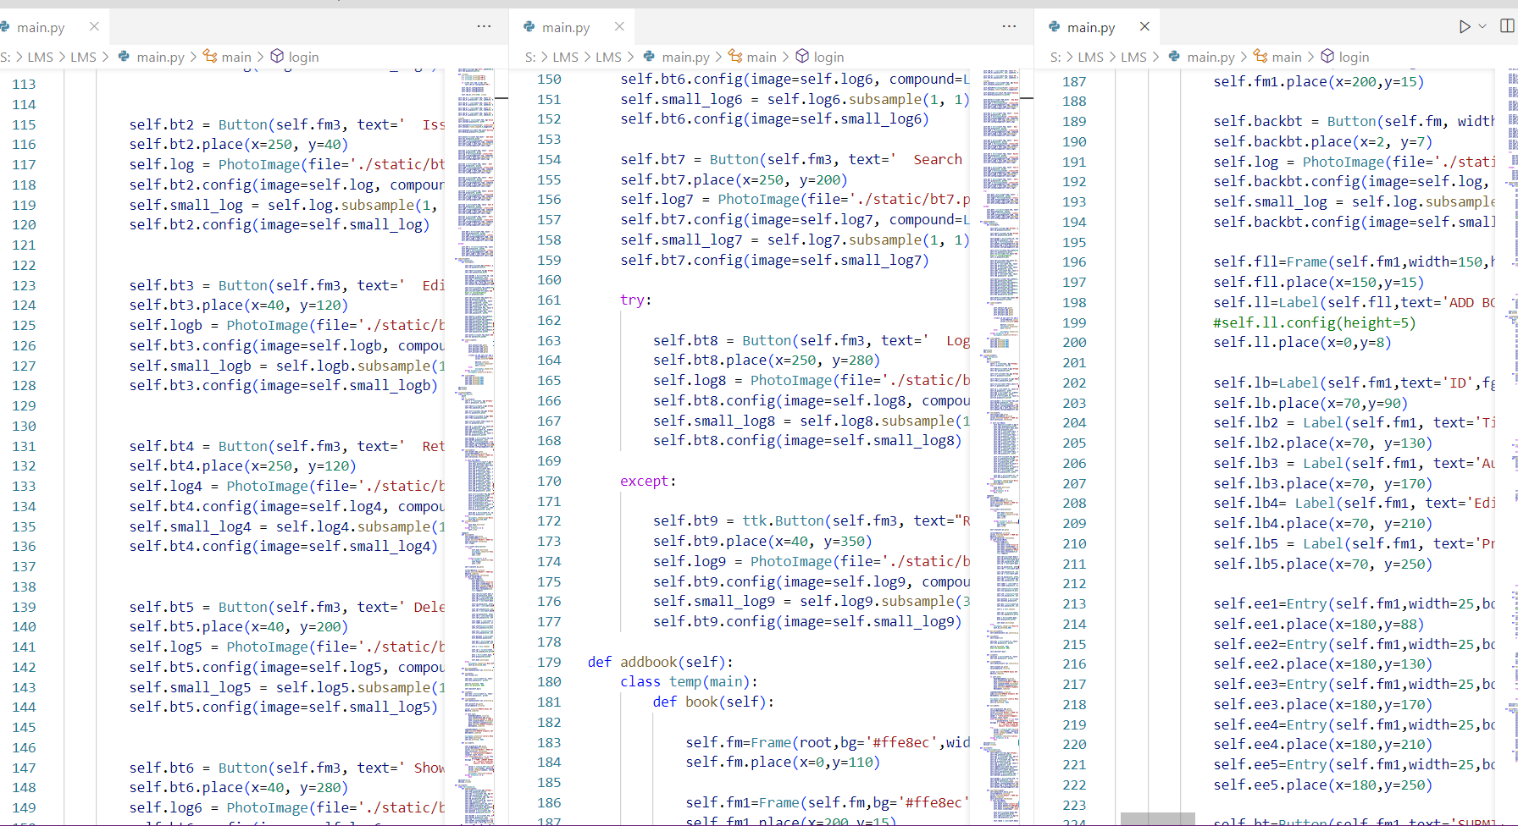
This is our main layout and we haven’t coded for the functions yet for the sake of program execution. One thing needs to observe here as in the program we have made a clickable label for the forgotten password with the help of the bind() function, which will now behave like a button.
And you can totally customize this with images, colors, and maybe positions. Here, buttons have also been added with some images for a visual better look.

Slide 14
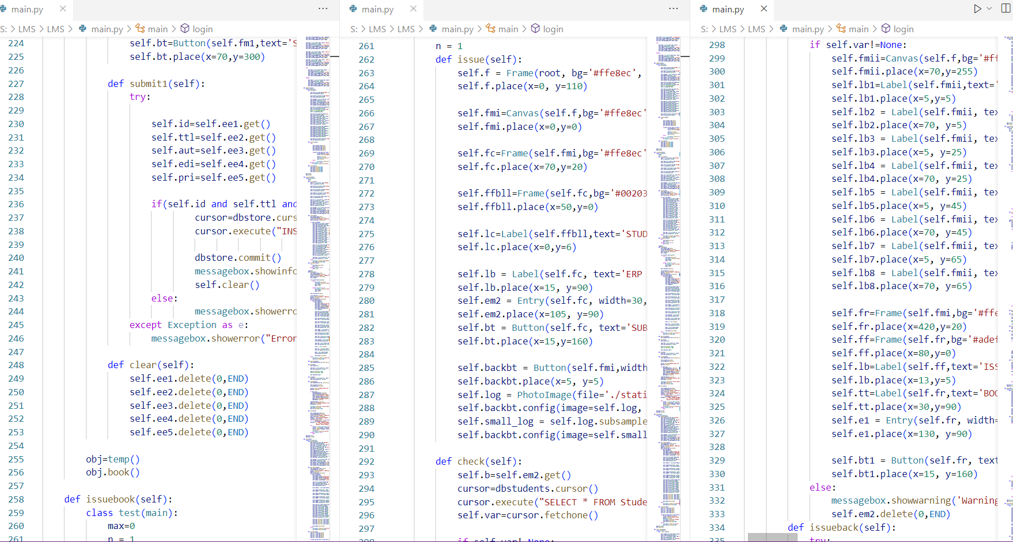
Login() makes use of login credentials consisting of User ID and Password and even sets for new password if required.
Addbook() give access to Admin to add more books in library.
Issuebook() issues the book to students based on their ERP and book ID.

Slide 15
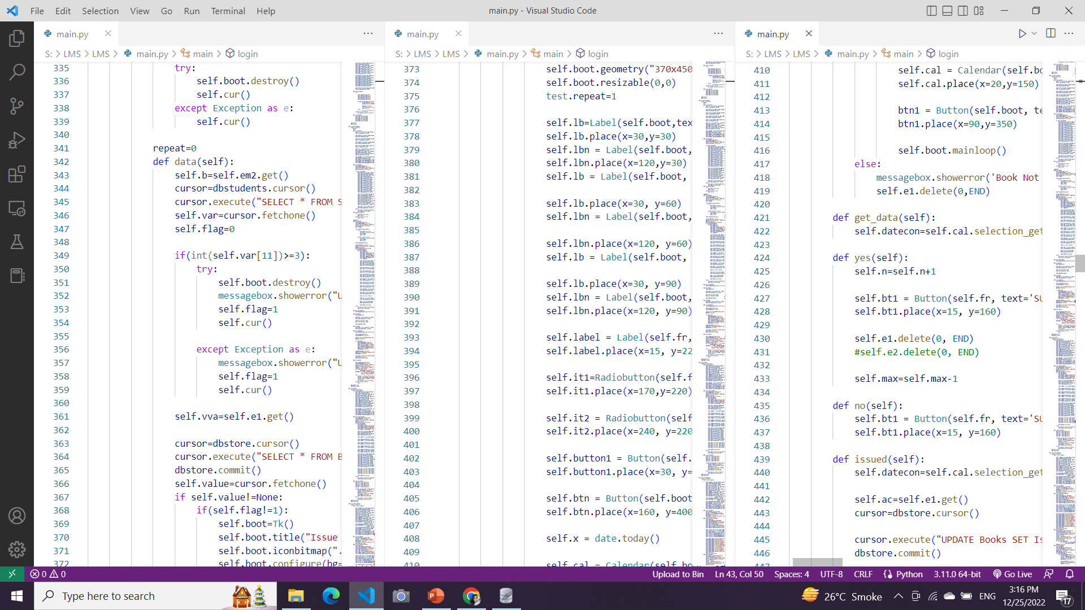

Slide 16
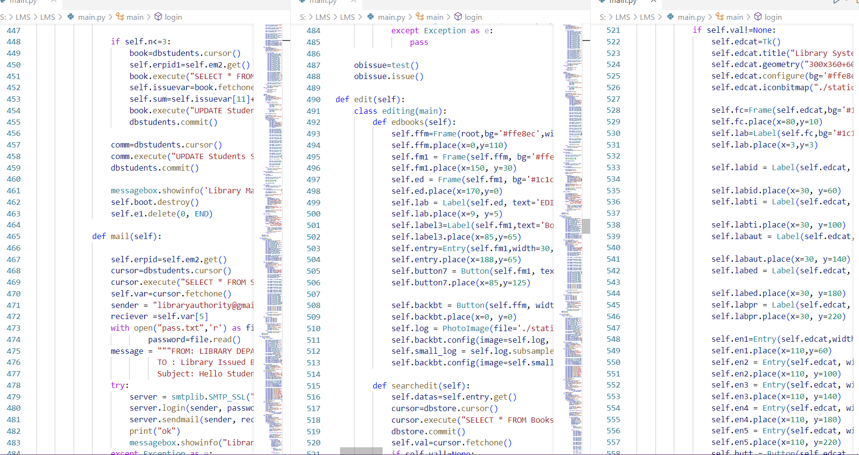
Edit() is used to edit any previously entered details of book.
Searched() is used to search a book if it is available or not for further any student to issue.
Mail() function is used to send mail as an remainder but it requires additional setup to functionally operate so at present it is of no use.

Slide 17
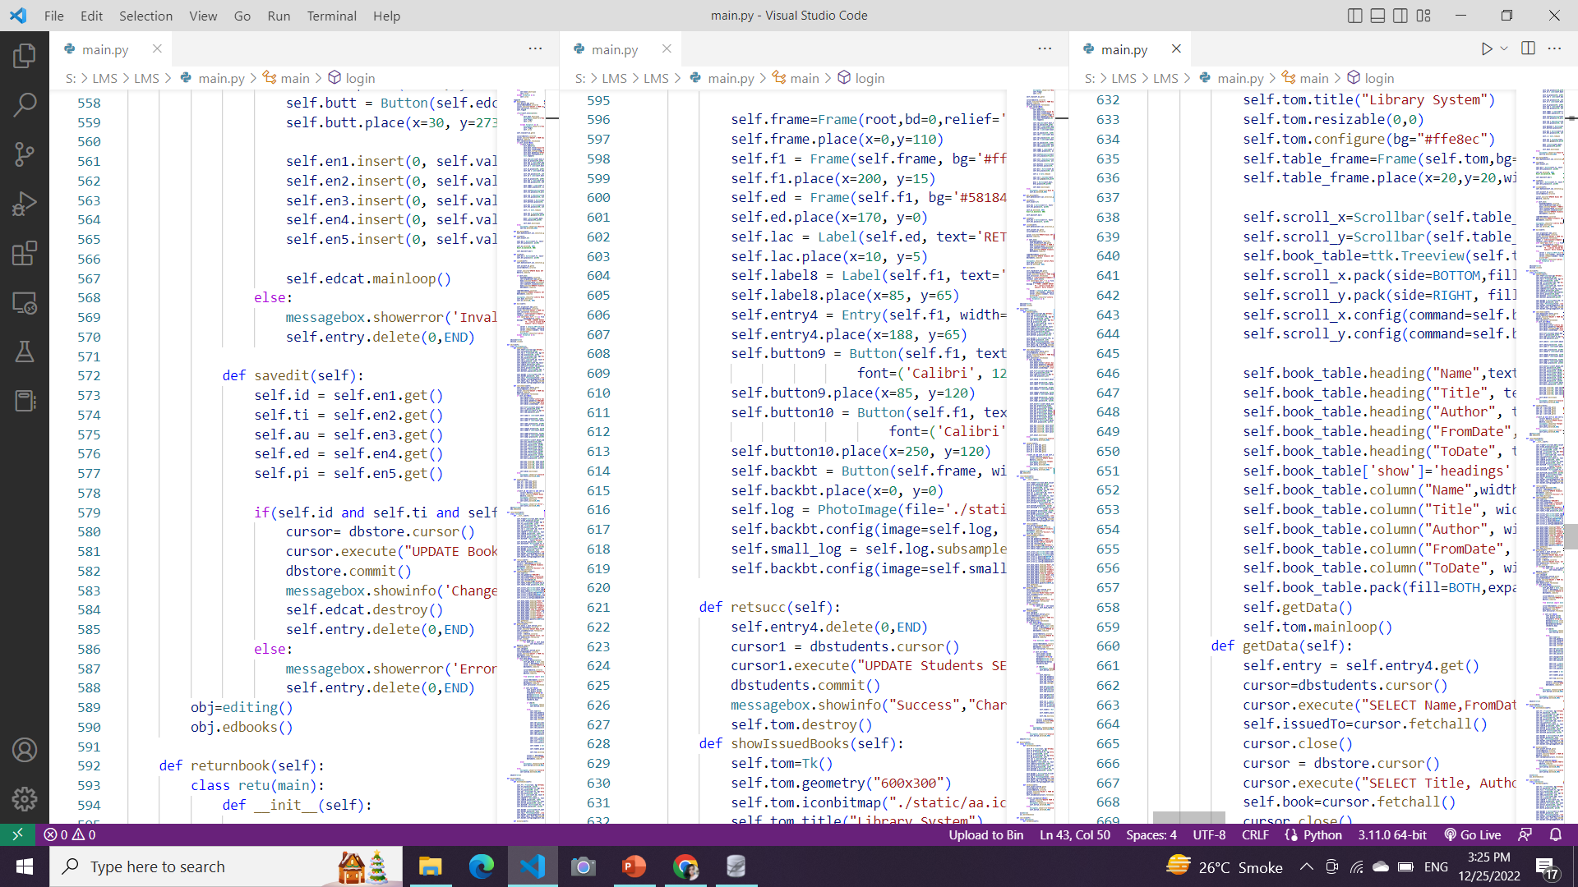
Return() books returns the book which was issued on som particular date and returned on due date.

Slide 18
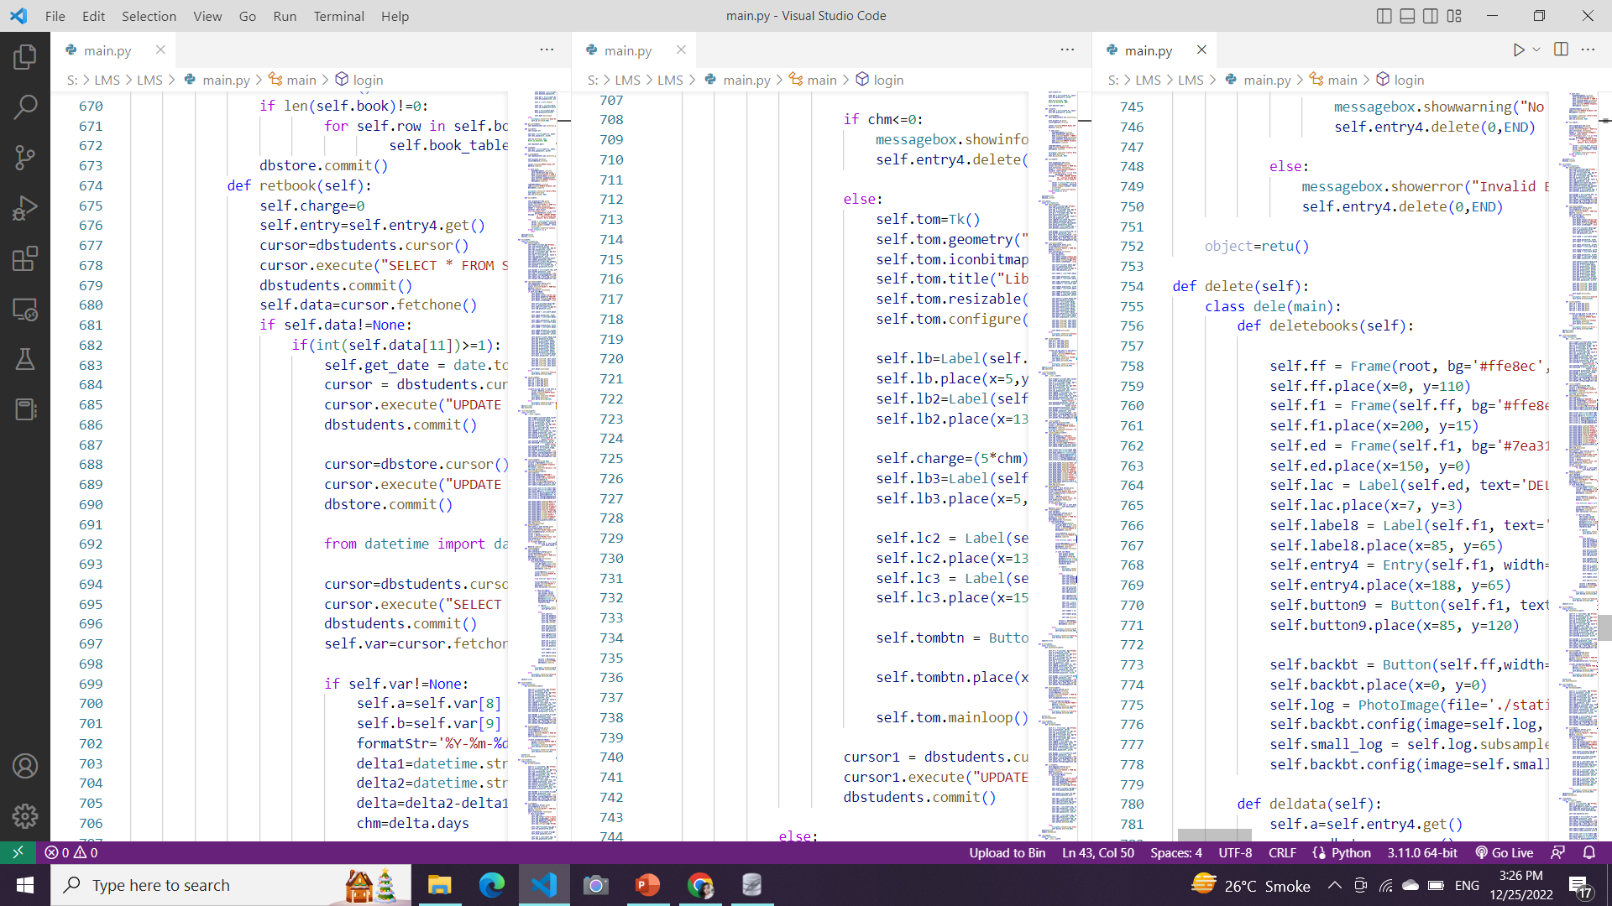
Delete() is used to delete books which is no further required and admin desires to remove from the library.

Slide 19
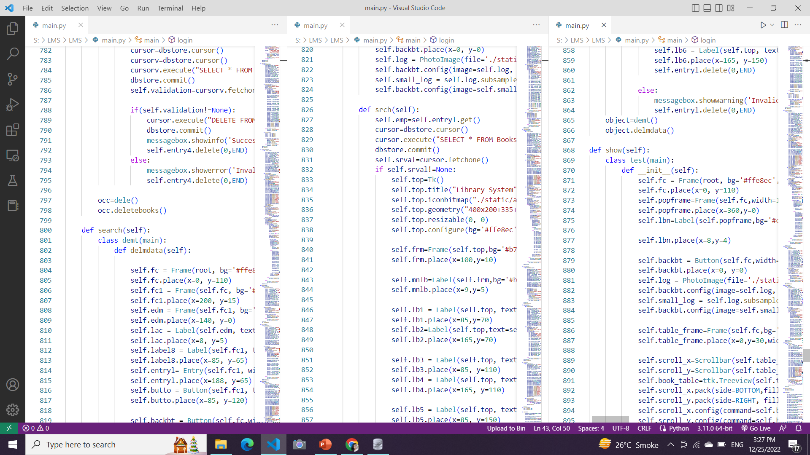
Show() function updates the output with which students has issued how many books and each is allowed to issue maximum 3 books at a time.

Slide 20
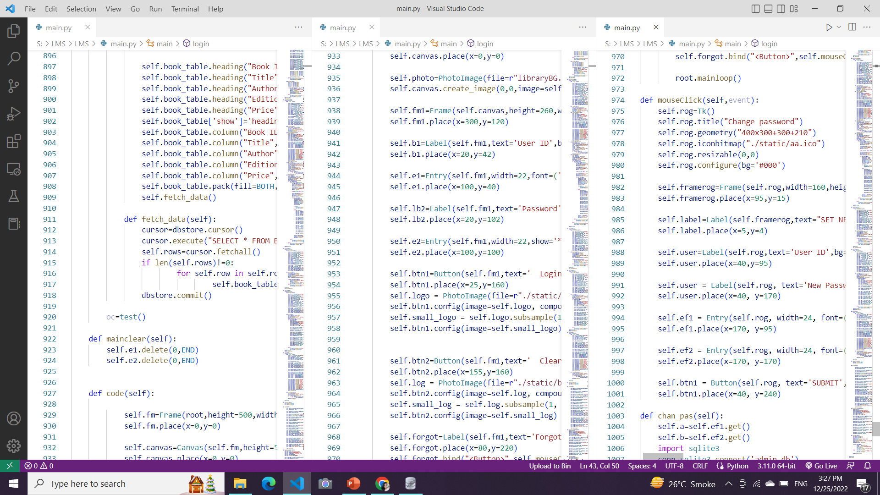

Slide 21
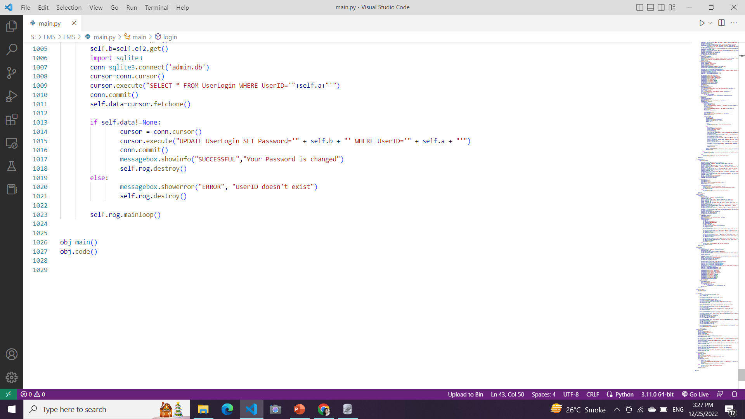
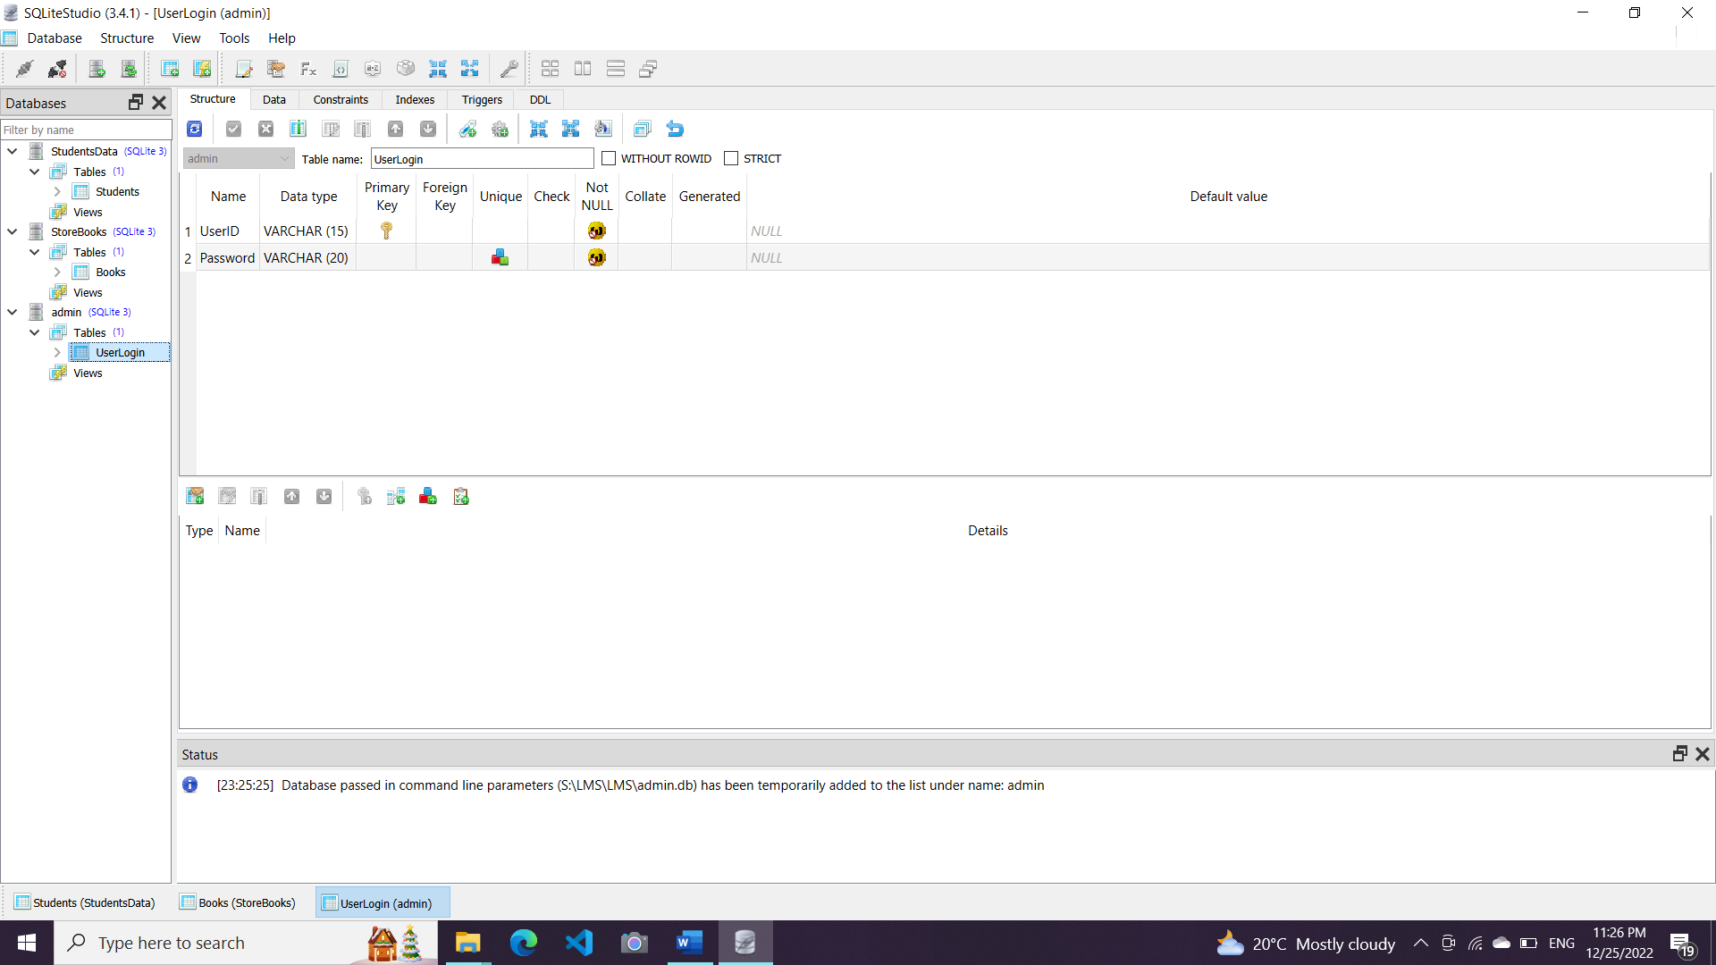
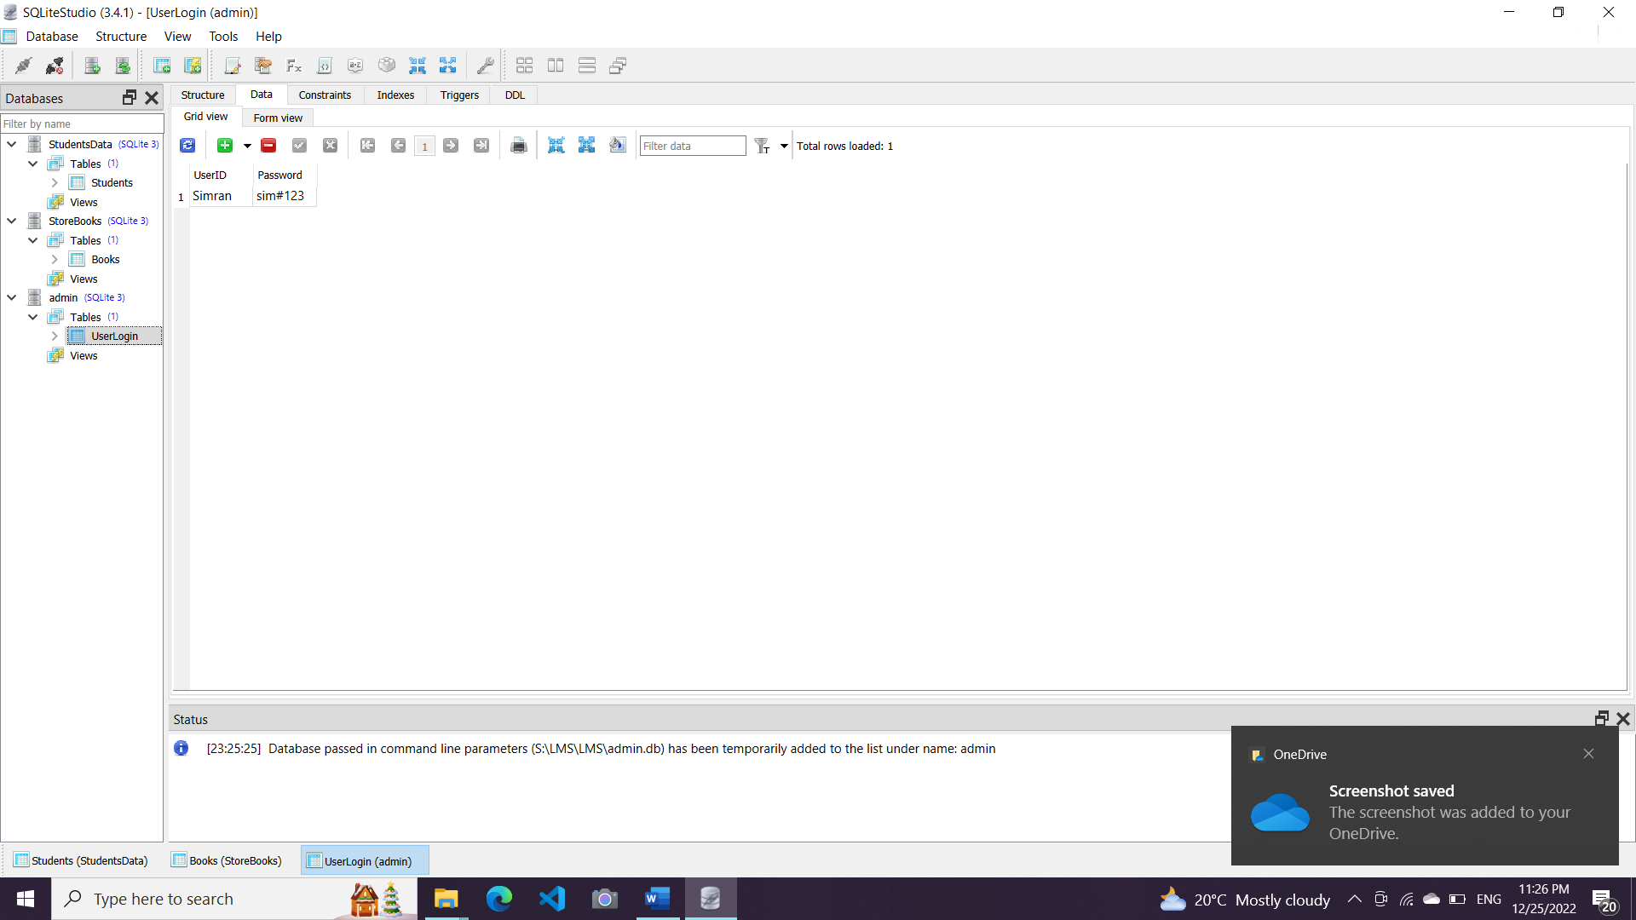
Following are the 3 databases :
Admin- contains column User ID and Password having details for the user who can access all the functions.

Slide 22
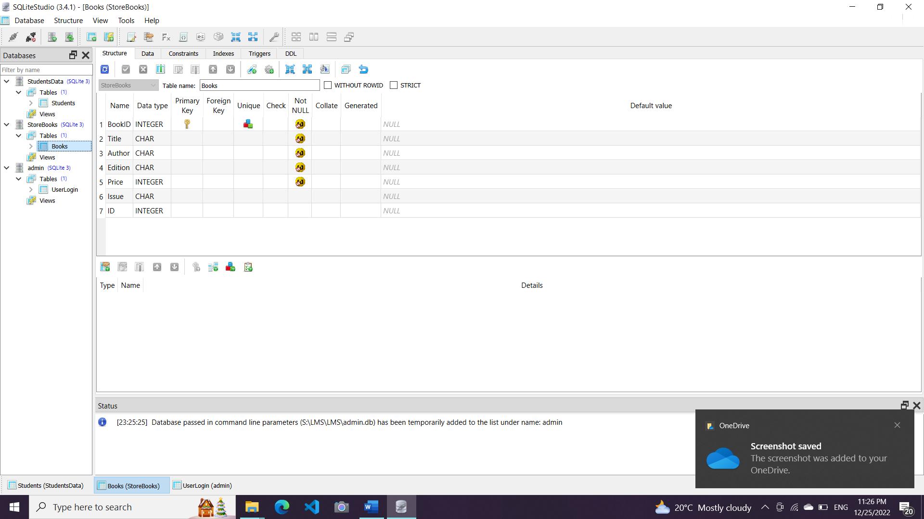
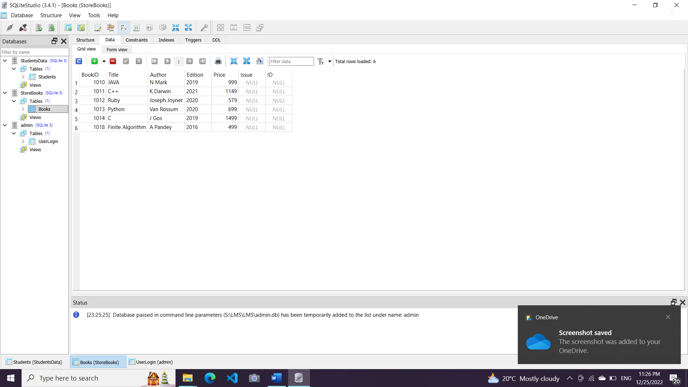
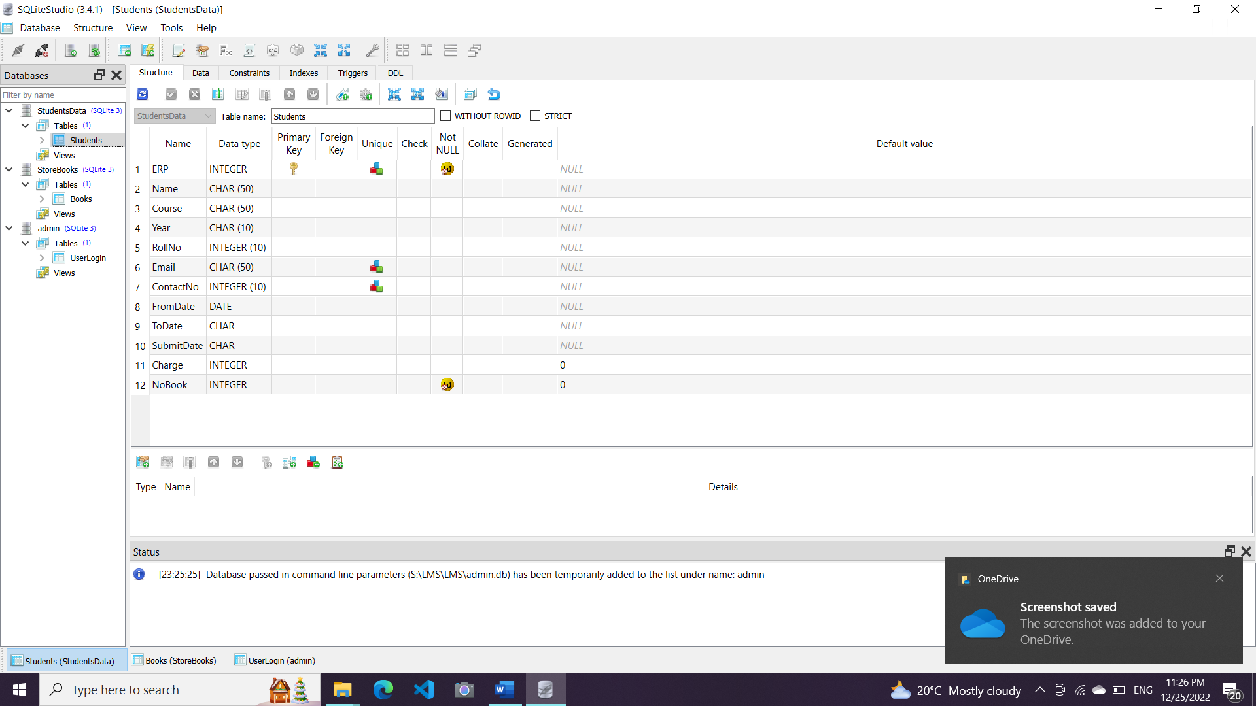
Books- contains column related to details of book such as Book ID, Title, Author, Edition, Price and when it was issued along with reference ID.

Slide 23
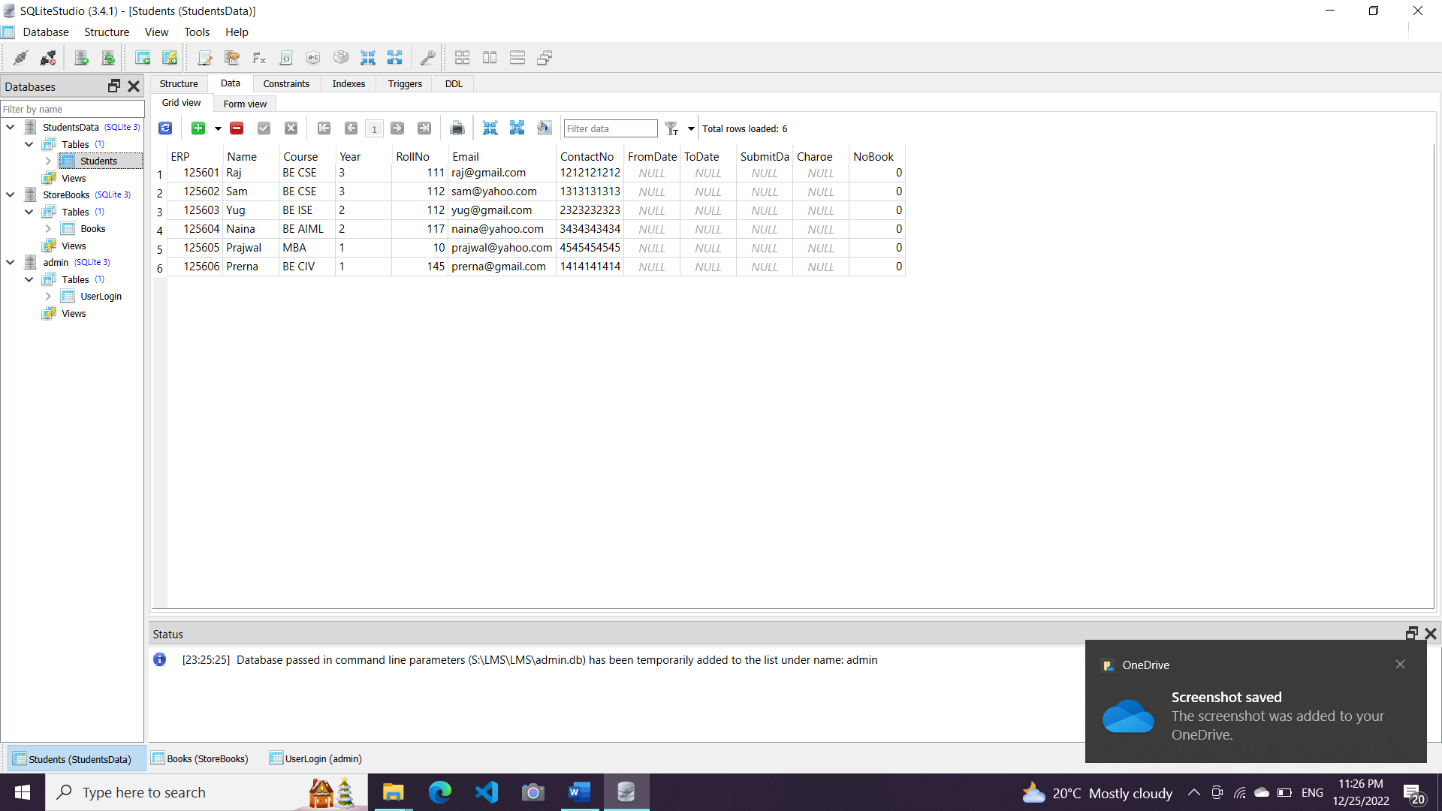
Student- contains details of student who was presently enrolled in library in terms of issuing a book or returning a book. Presently it has very few number of students but a large database can be present.
Student details such as ERP, name, course, year, roll no., email, contact no, and issued date as well as return date, including fee charged and no. of books issued.

Slide 24
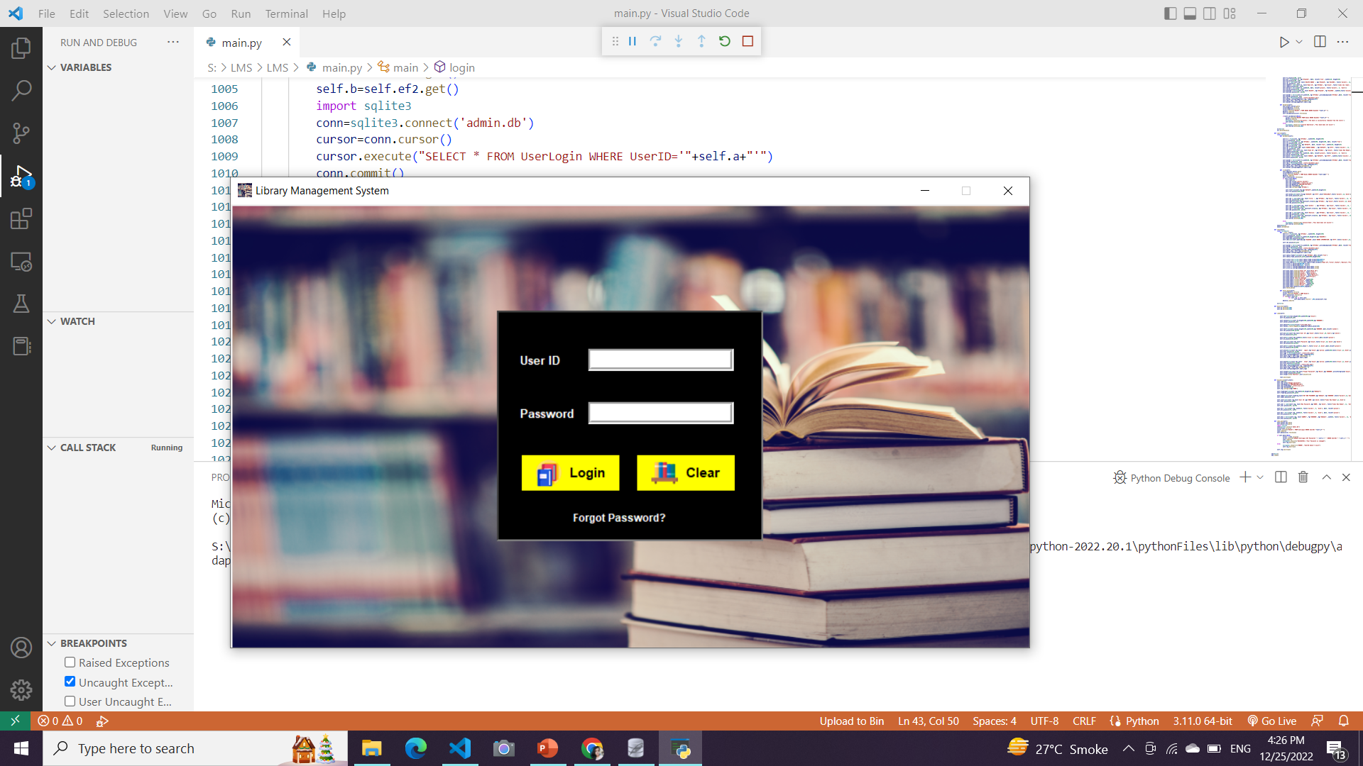
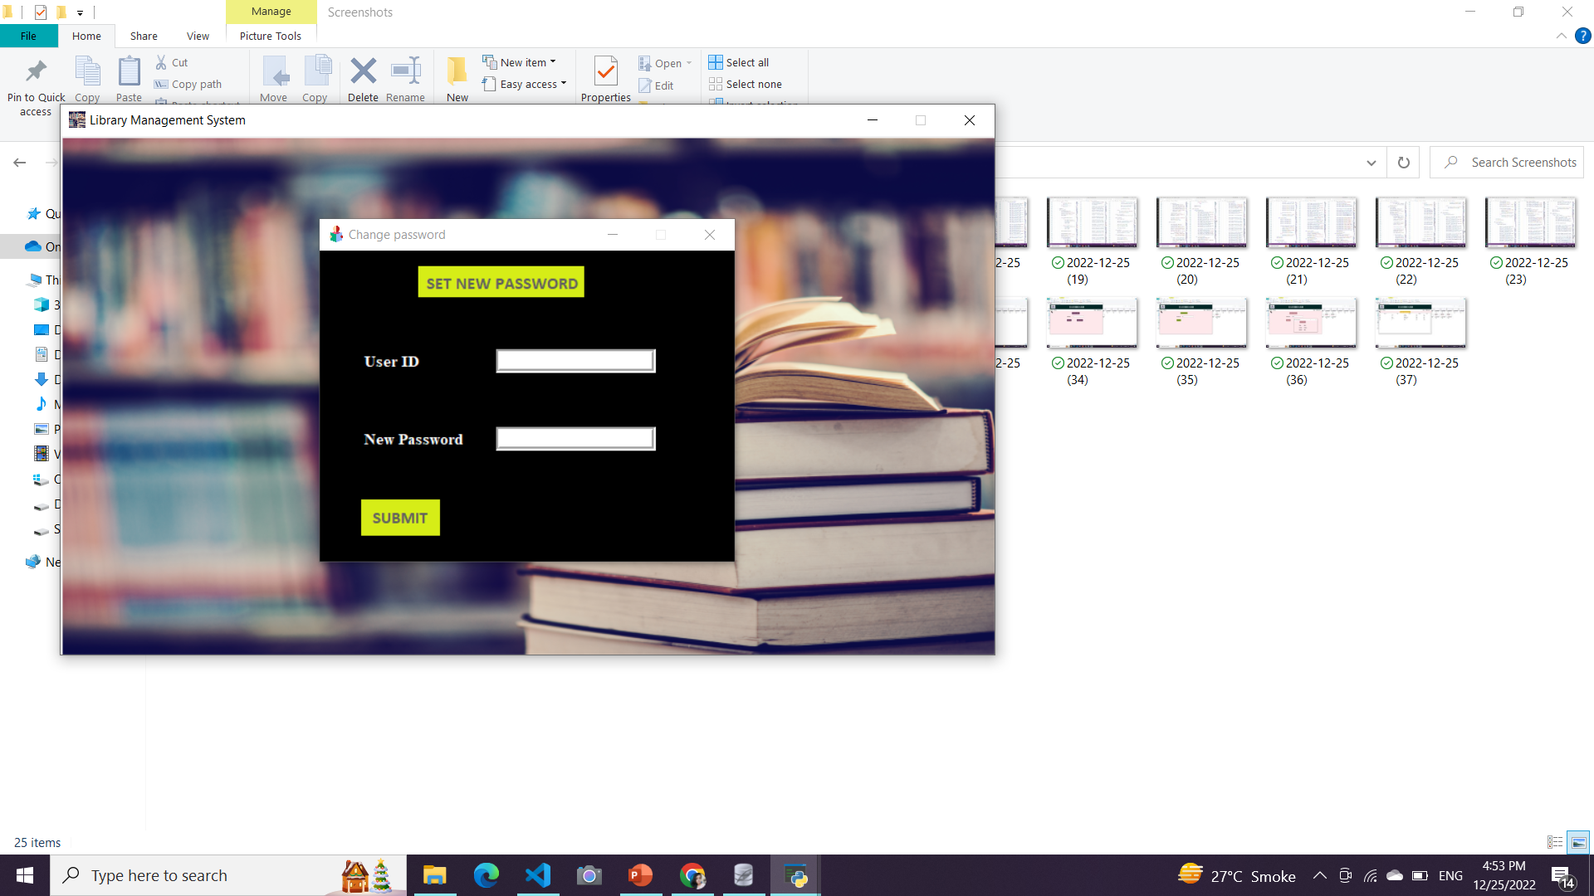
OUTPUT
This is a login interface showing usual buttons like login where Admin puts the User ID and Password.
This shows up when Admin wants to set a new password for the Management System.

Slide 25
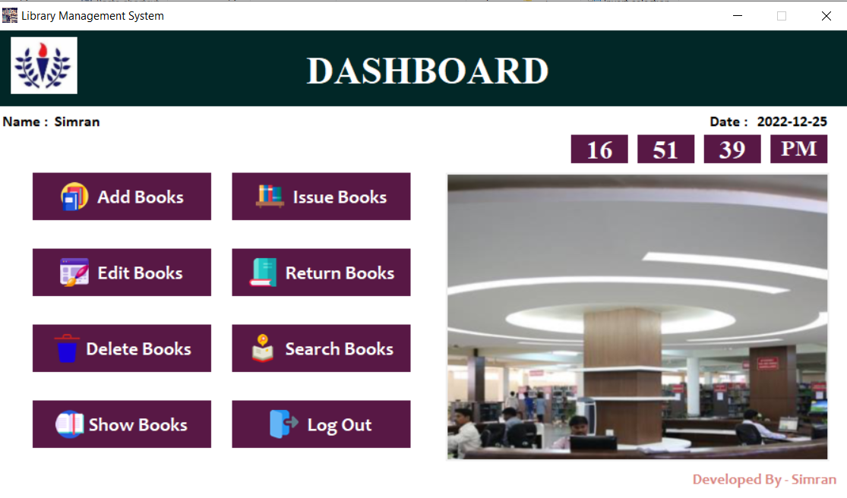
After login, such panels show up where all necessary functions are there and a Admin/User can go to any option as per requirement.

Slide 26
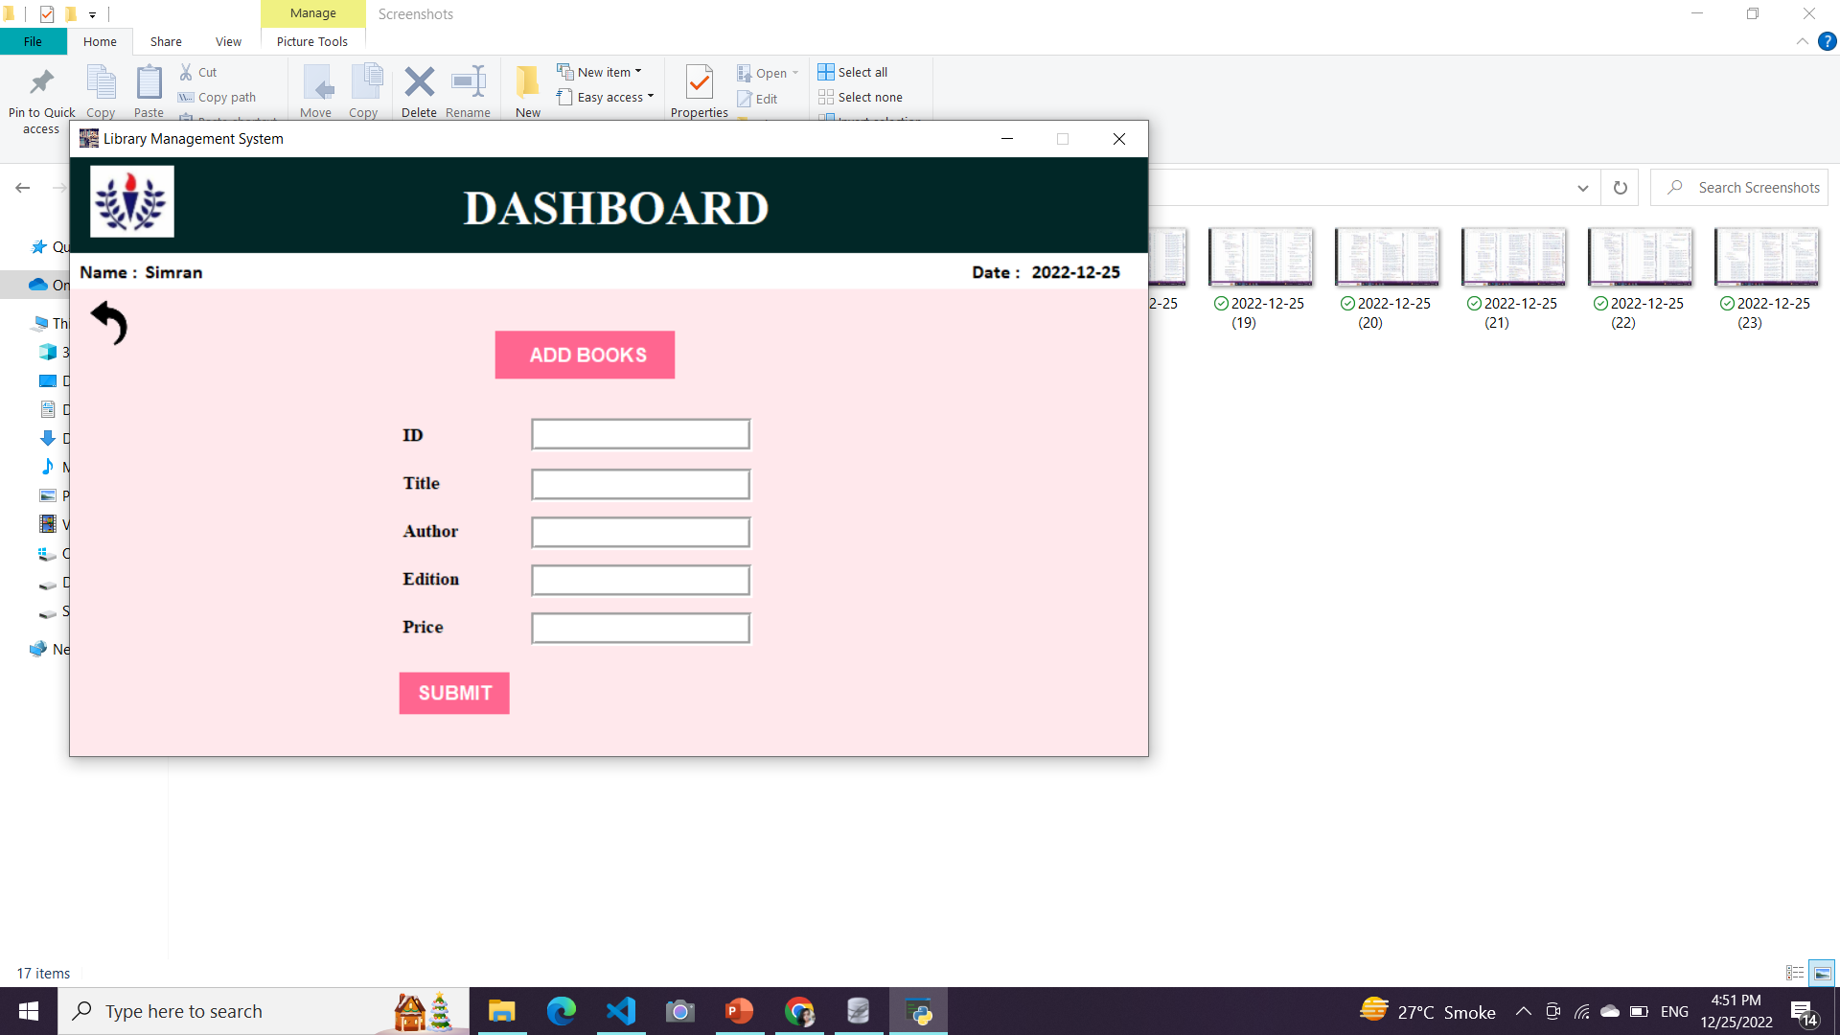
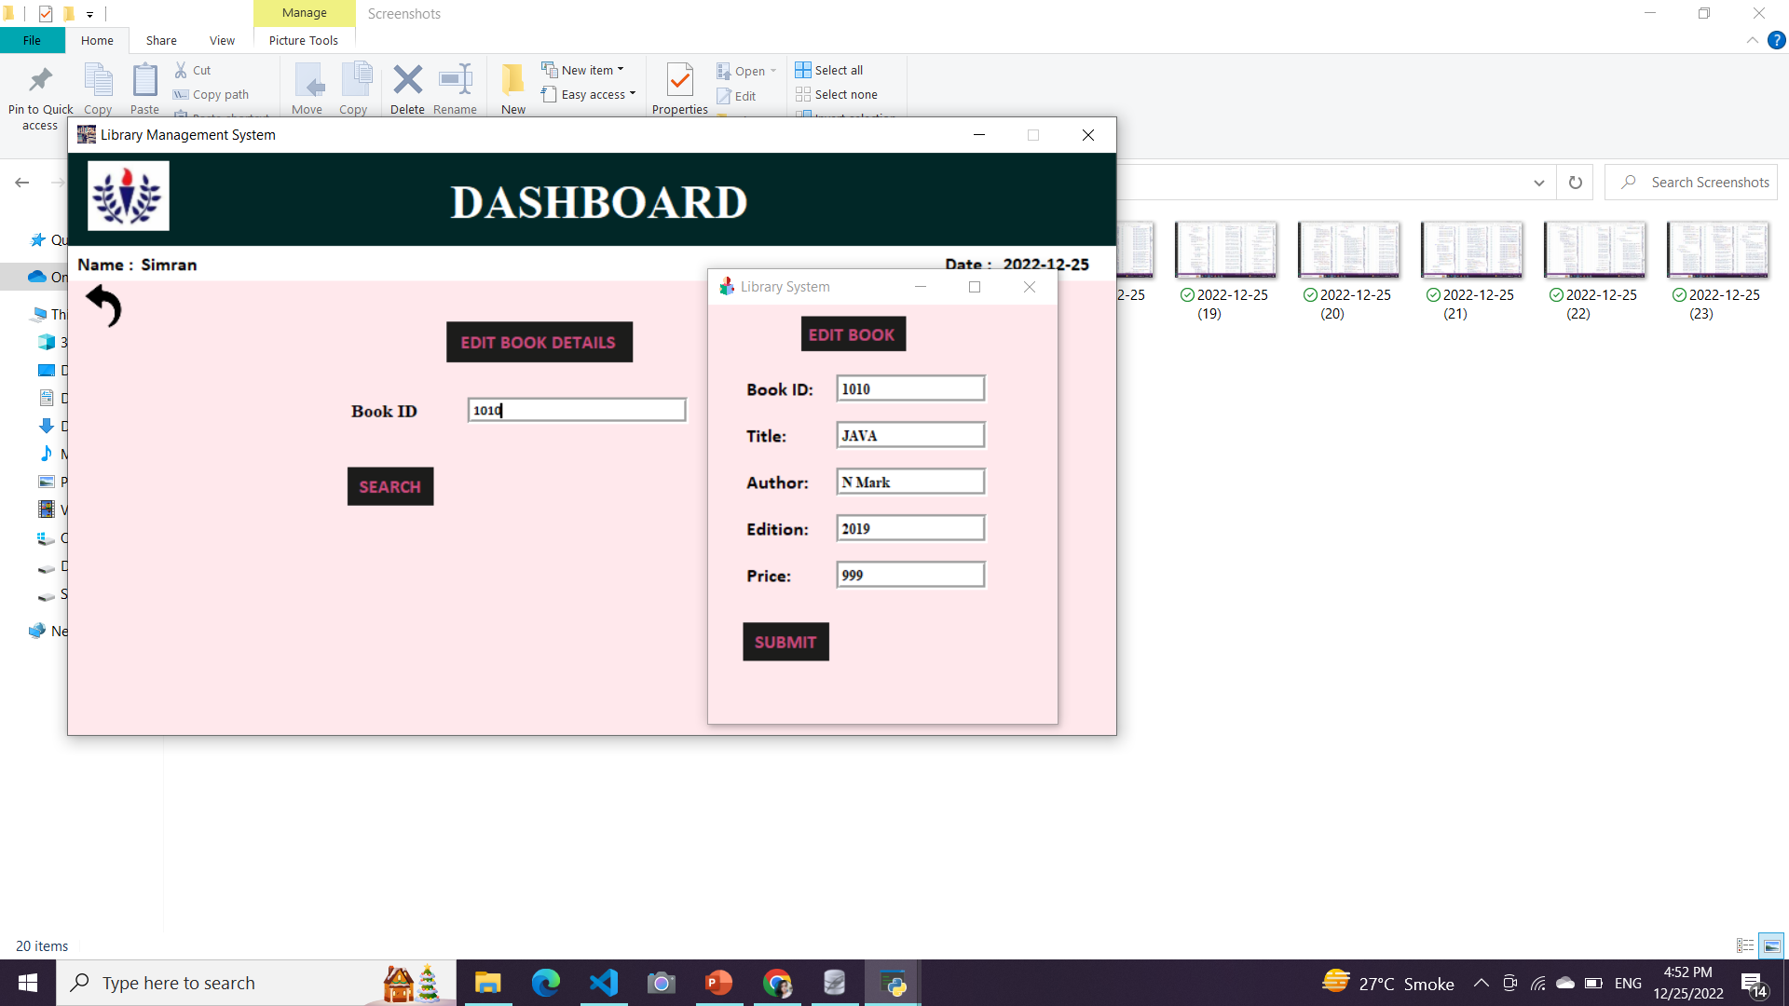
This is where one can add books that should be there in a library.
One can edit details in already entered book in a following way.

Slide 27
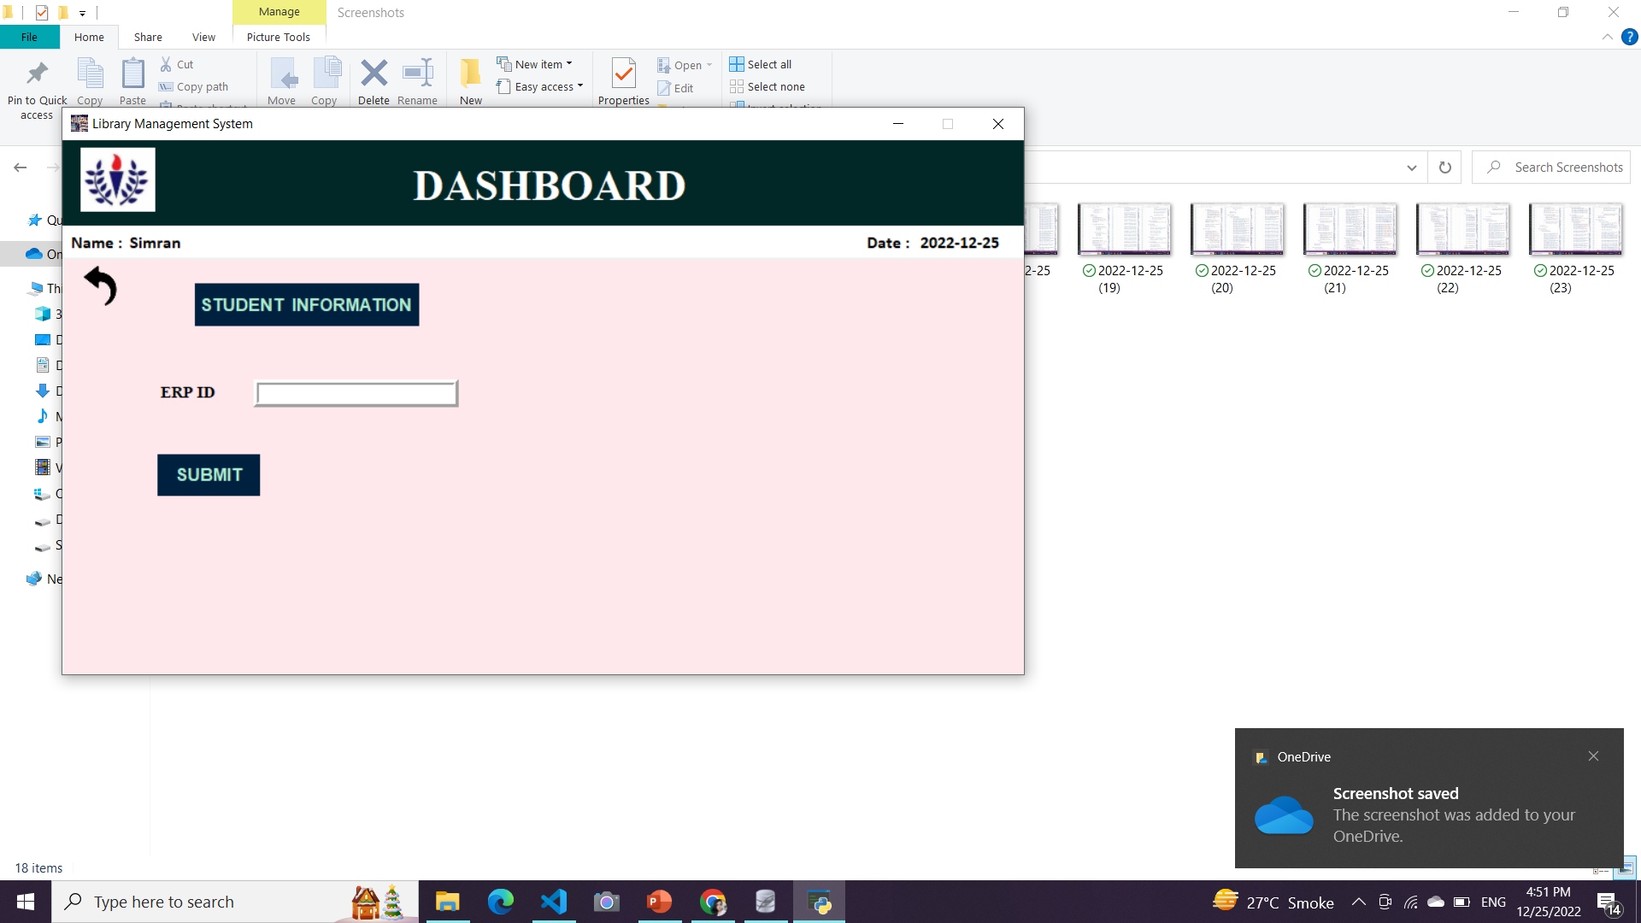
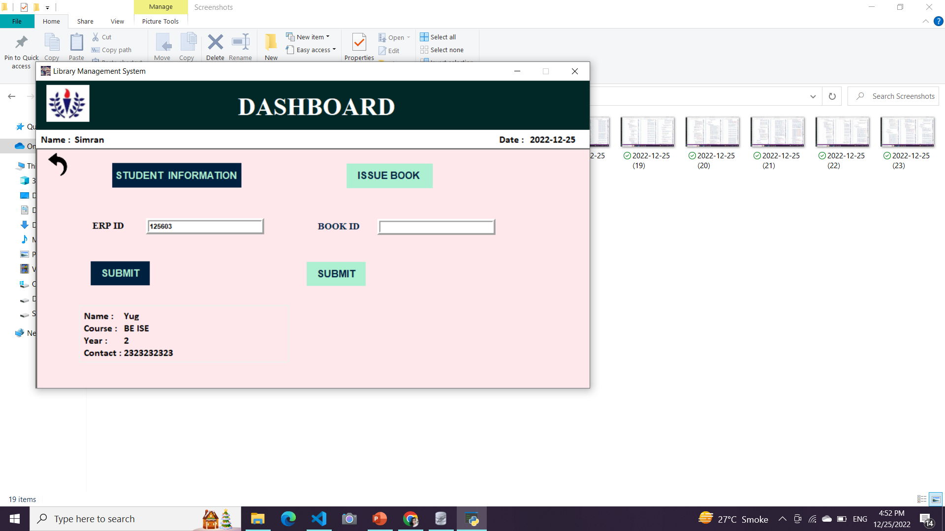
This opens up when Admin chooses the option : Issue Books.
It asks for Student’s ERP and respective Book ID which he/she wants to get issued along with date.

Slide 28
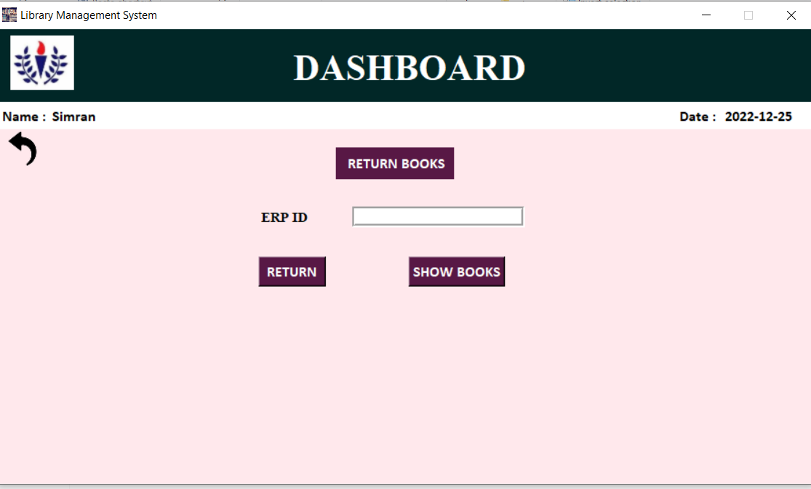
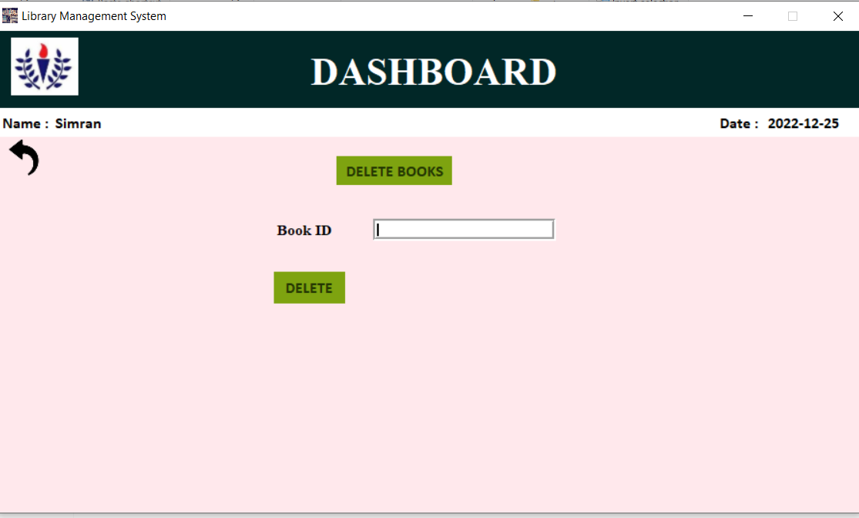
This opens up a student wants to return a book along with Date and it even shows the currently issued book by a student according to student’s ERP.
One can delete book which is no further required by the Library.

Slide 29
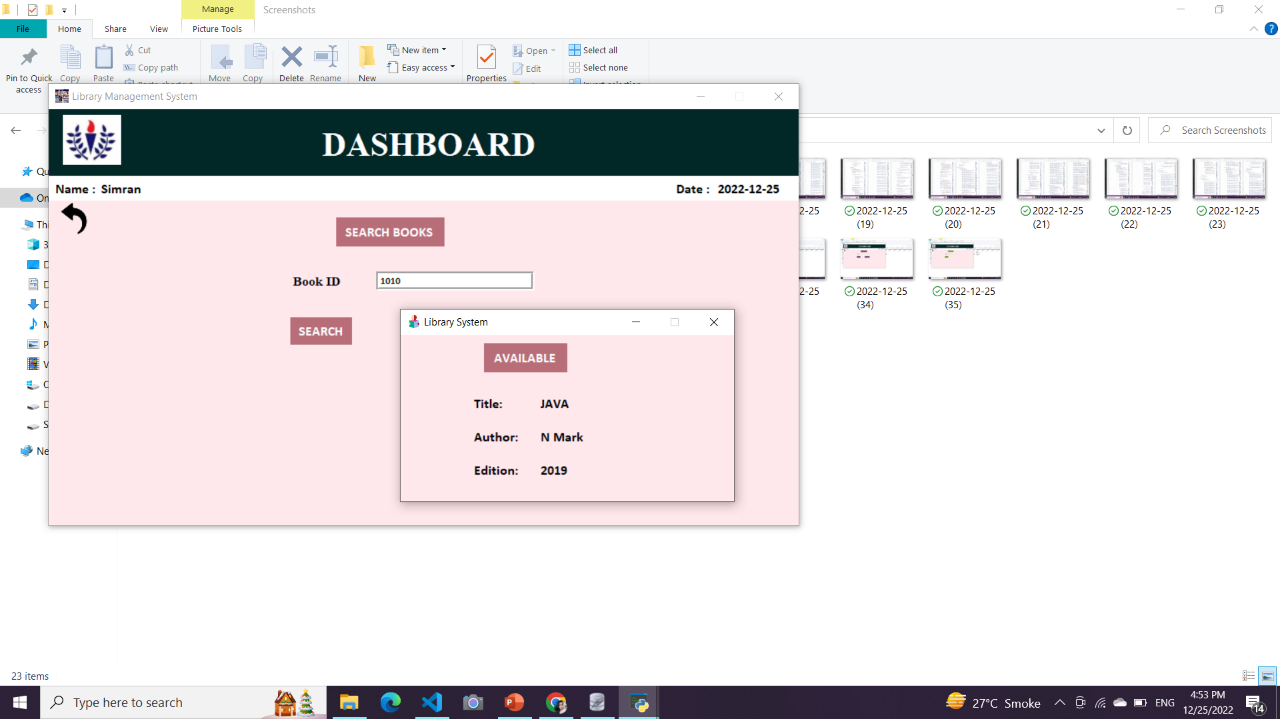
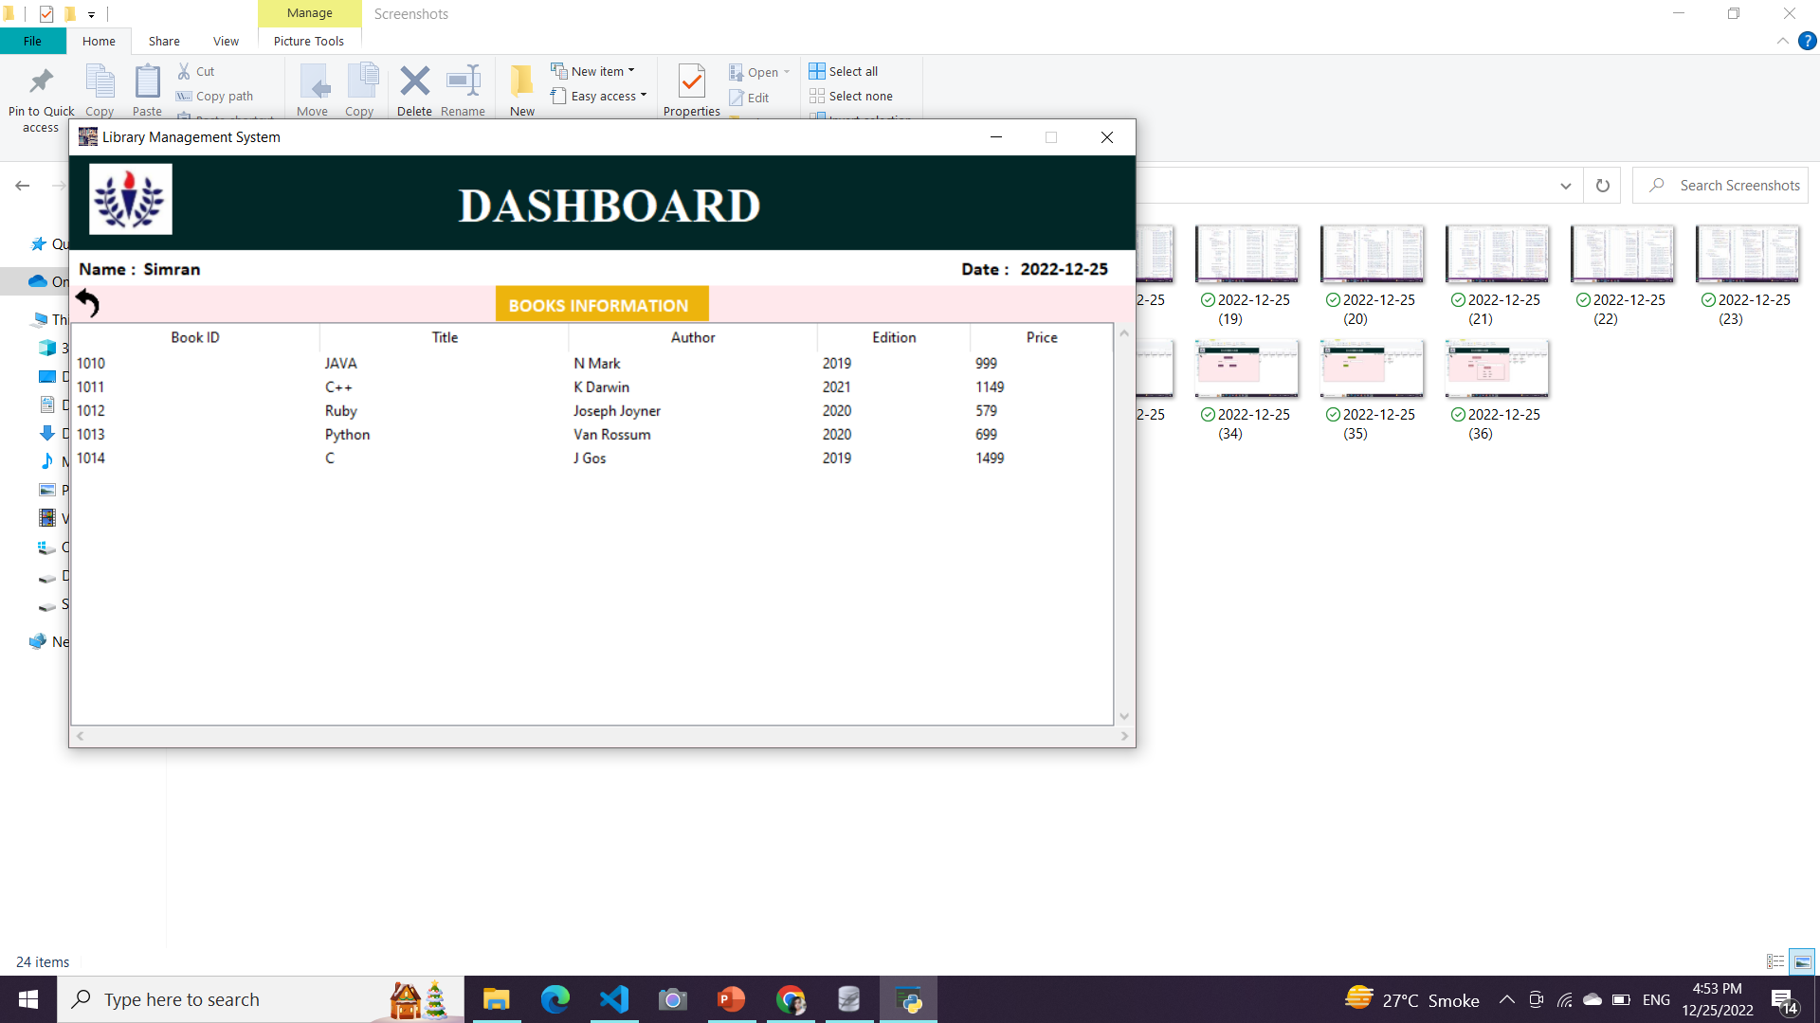
Search book option exists to show available books at present for a student to issue further.
Finally this option shows all the book present in the library.

Slide 30
Conclusion
The project has been completed using SQL and Tkinter- GUI based on Python. Library Management System aims at providing ease in order to reduce manual work and store data to its precision.
This project consists of various options which are needed in a library and gives the Admin the functions which is not accessible by the students. Furthermore by the use of Login ID and Password, this is highly secure as no data can be lost and be referred in future too for reference.
In future, it can be more manipulated by adding more functions such as making a global library like IIT Durgapur and adding more Login credentials for each student so a regular can maintain his/her record and store in one platform for lifelong usage.
Usage of SQL makes it more functionable and easy to store data with regular updates as we have so many SQL Commands which makes the project standout and worthy.

Slide 31
References
[1] Wikipedia
[2] Online Compiler
[3] Youtube (for understanding concepts)
[4] GeeksforGeeks
[5] College Notes

Slide 32
Thank you

